Slide 1
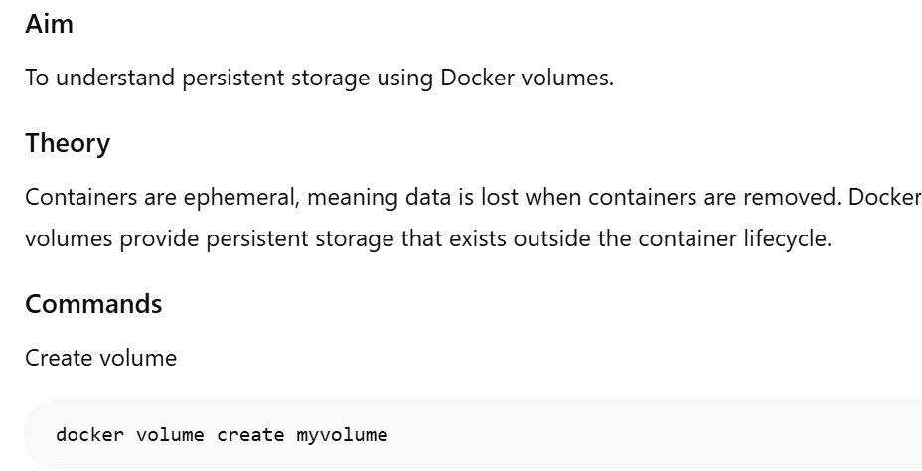
Lab 2: Docker Volumes

Slide 2
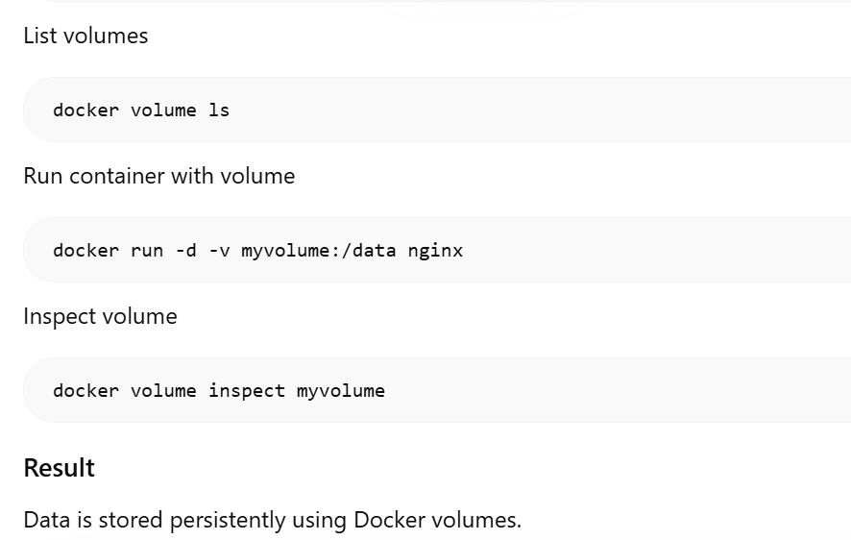
Lab 2: Docker Volumes

